Slide 2
Please

Slide 4
YESBU

Slide 5
LYM

Slide 7
First convention

Slide 8
Lund, Sweden

Slide 9
Lund, Sweden

Slide 10
Second convention

Slide 11
Turin, Italy

Slide 12
GEYC 2004

Slide 13
GEYC 2004

Slide 14
Alexandria, Egypt

Slide 15
Dubai , 2006

Slide 16
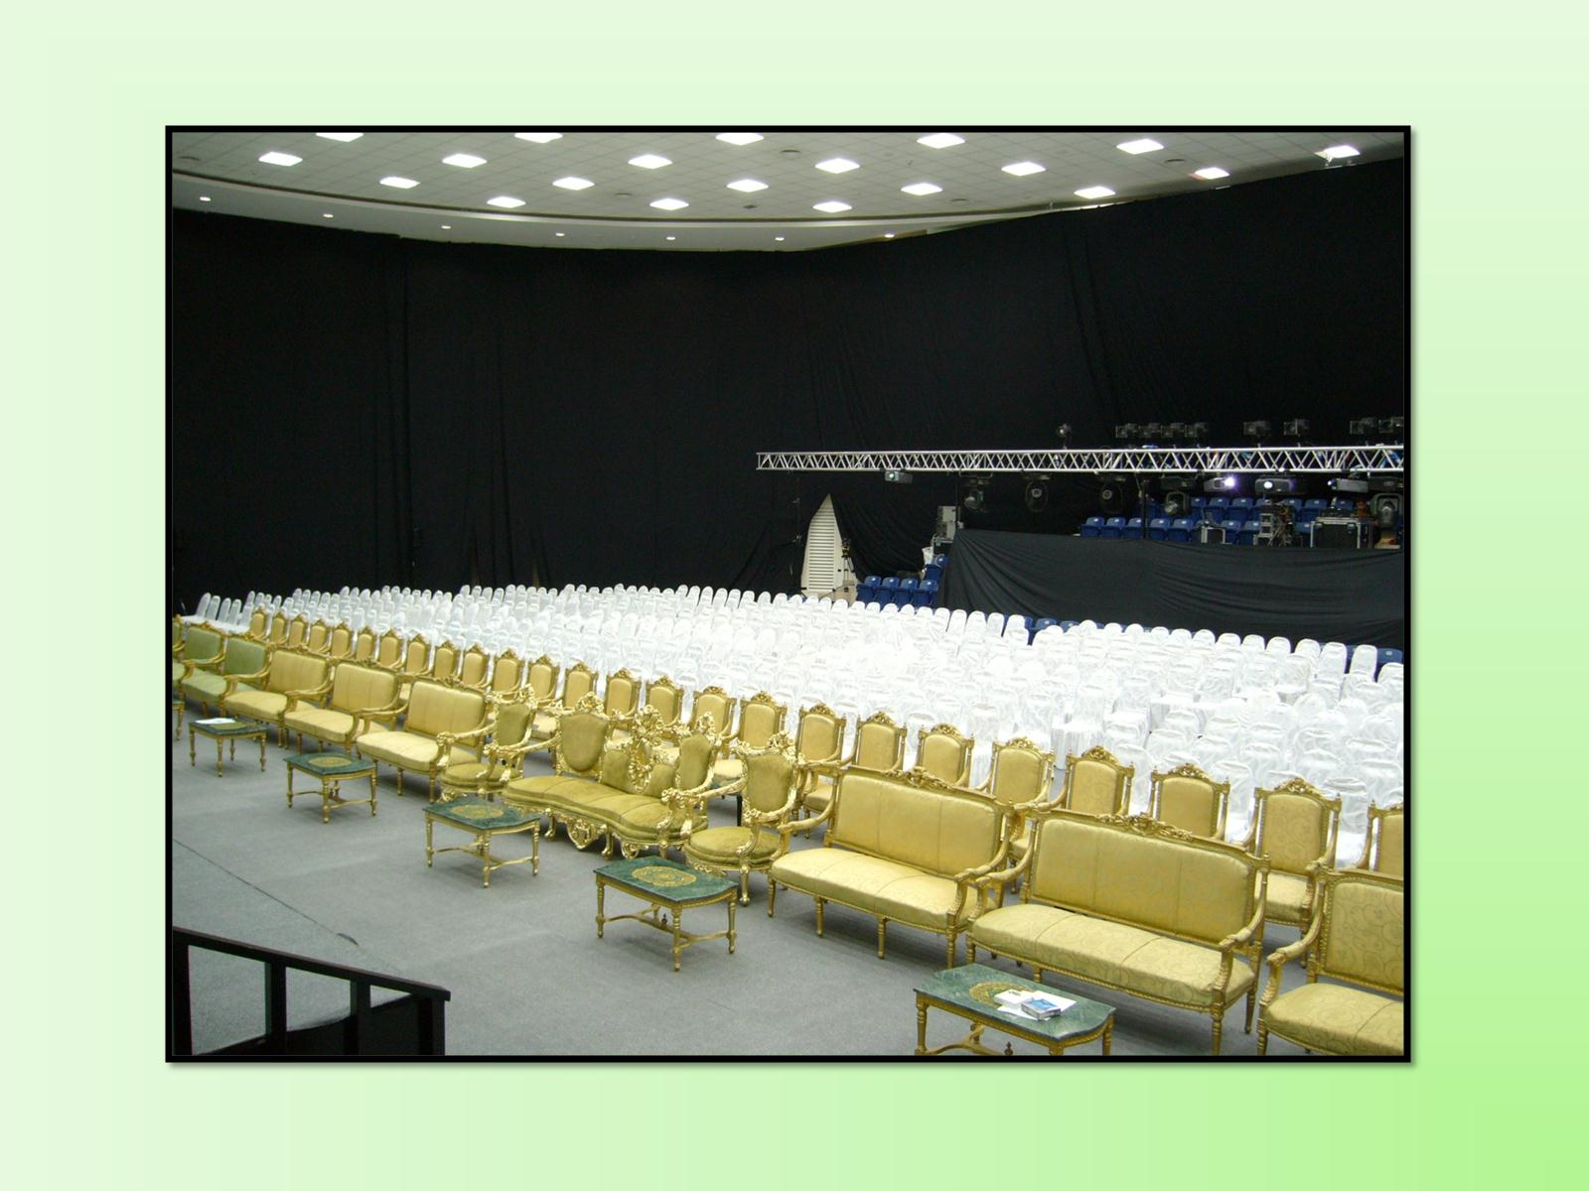

Slide 17
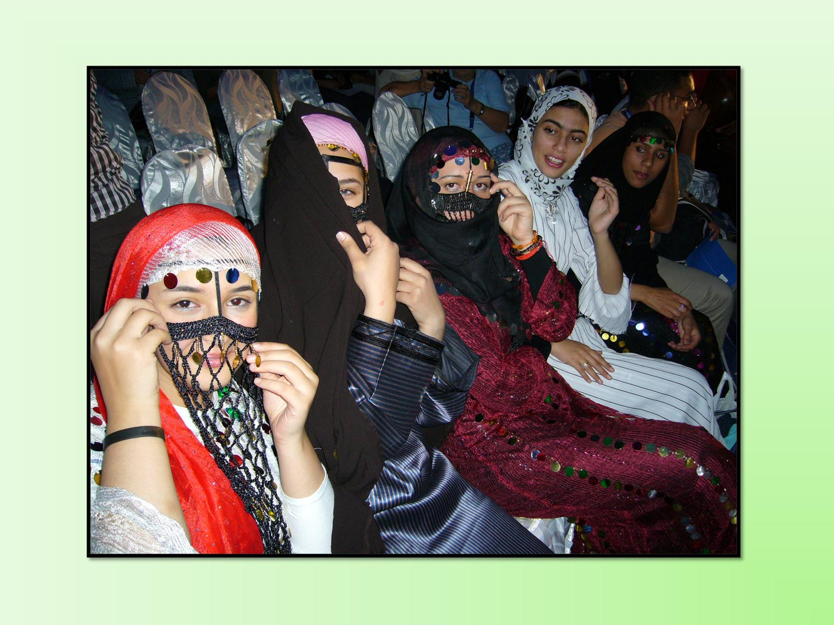

Slide 23
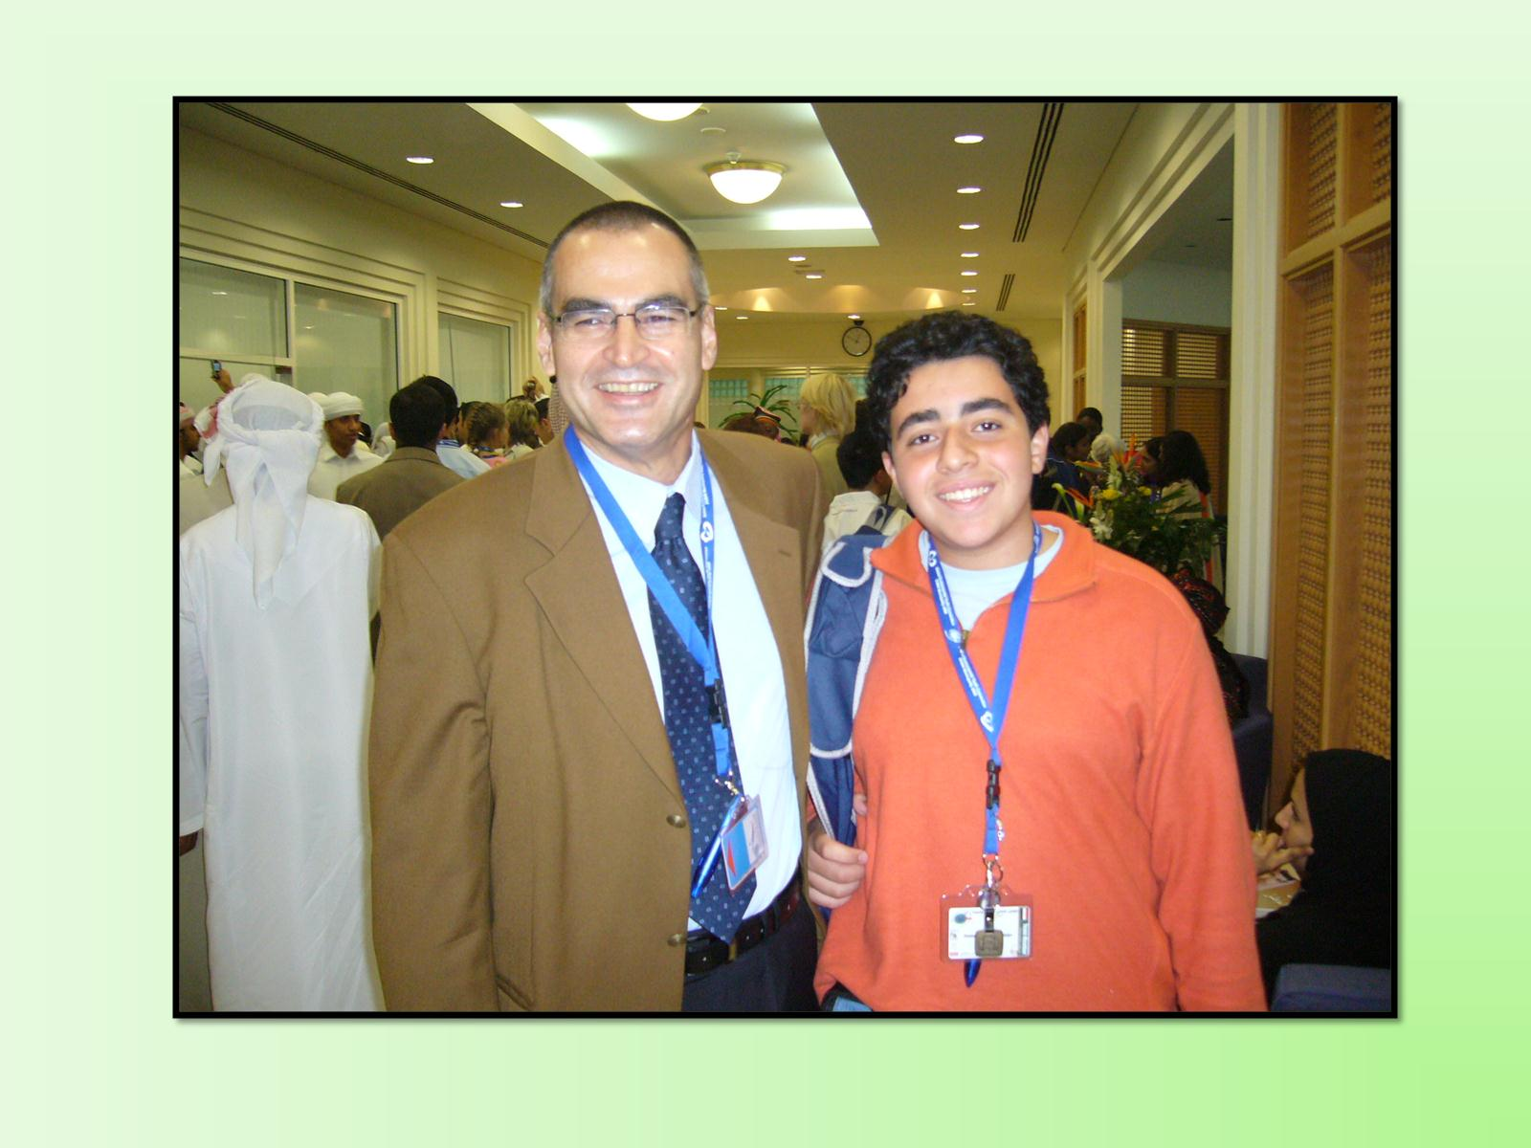

Slide 26
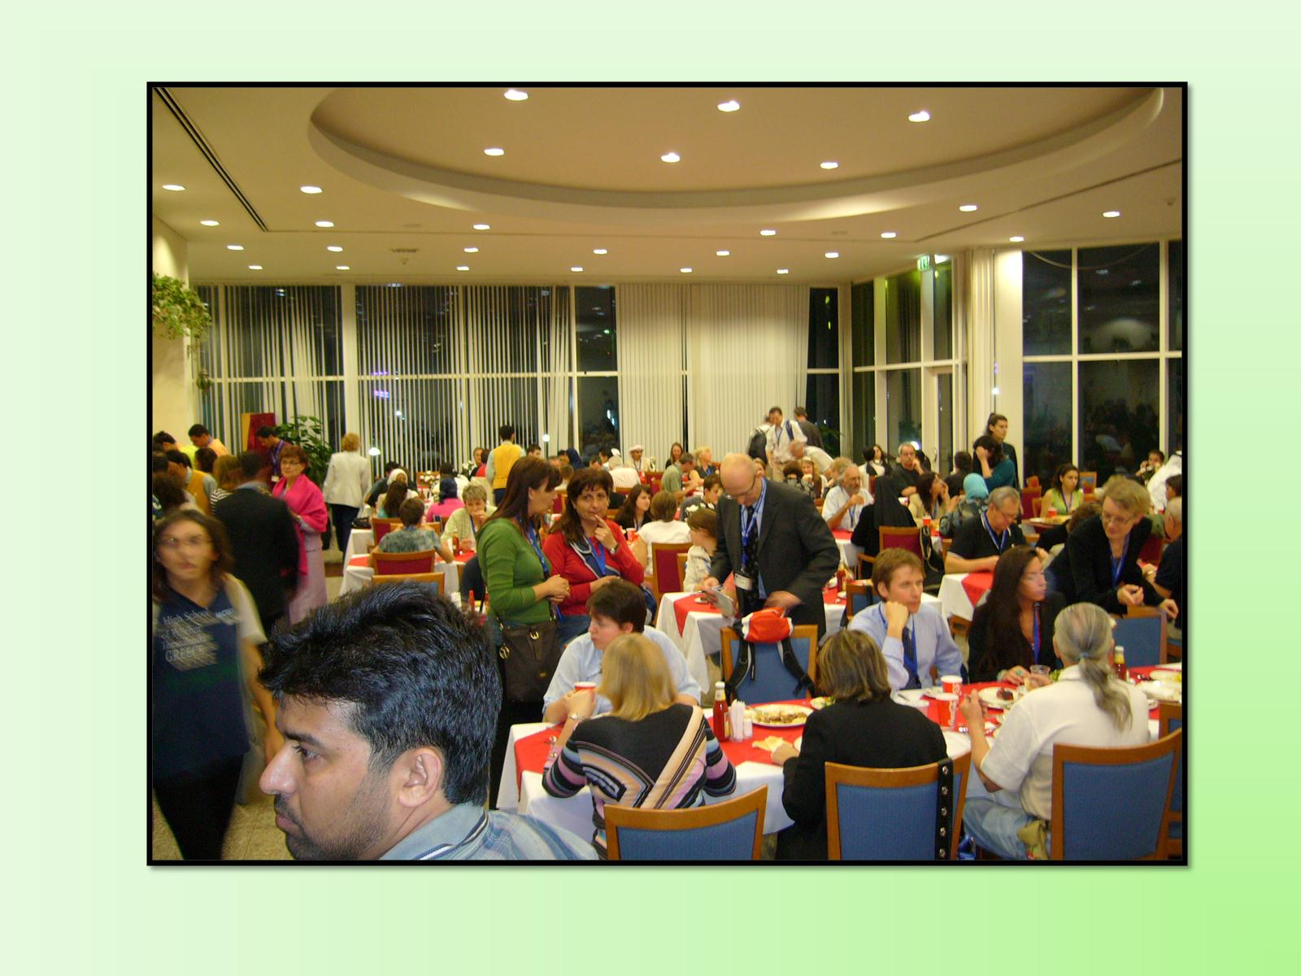

Slide 28
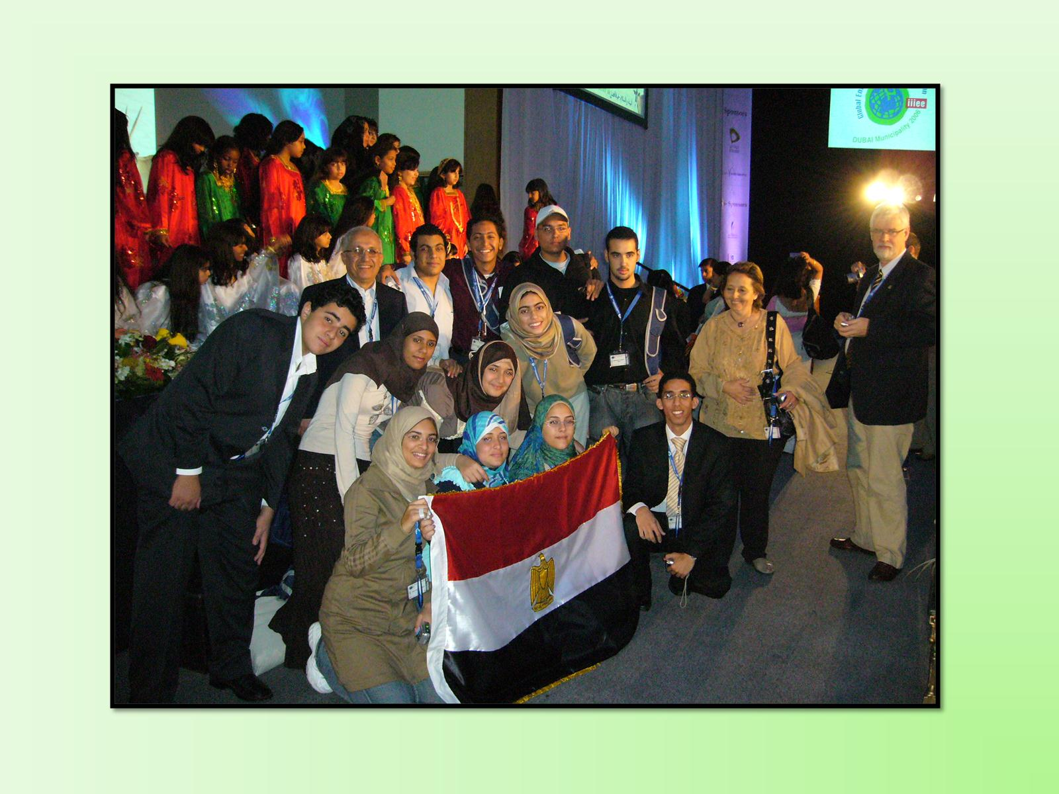

Slide 29
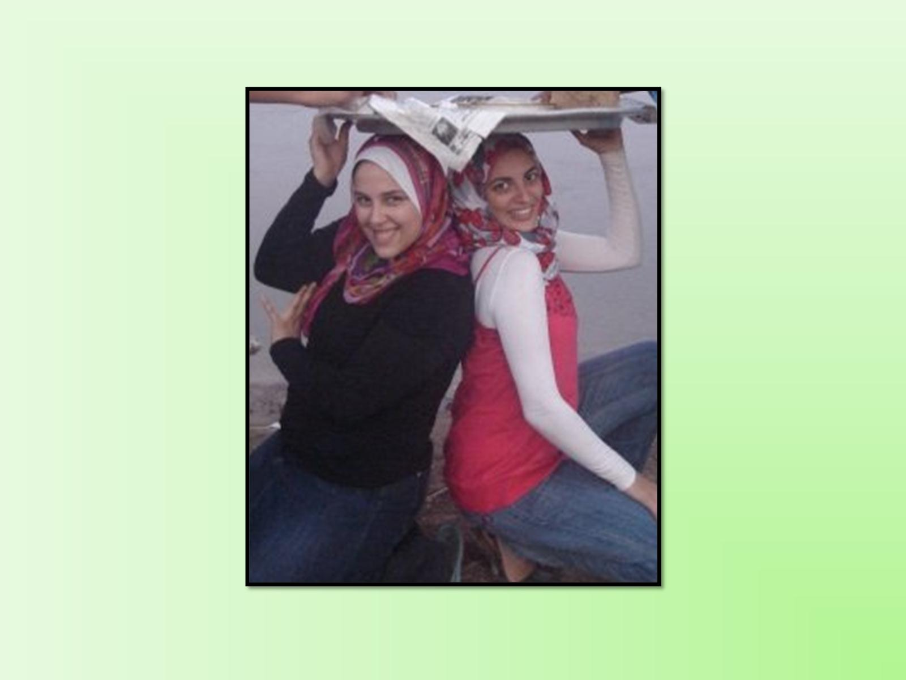

Slide 31
Sustainable ?

Slide 32
Preventive ?

Slide 37
Certificate

Slide 39
YESBU

Slide 40
تعريف

Slide 41
تعريف

Slide 42
الأنشطة

Slide 43
الأنشطة

Slide 44
التفاعل

Slide 45
التفاعل

Slide 48
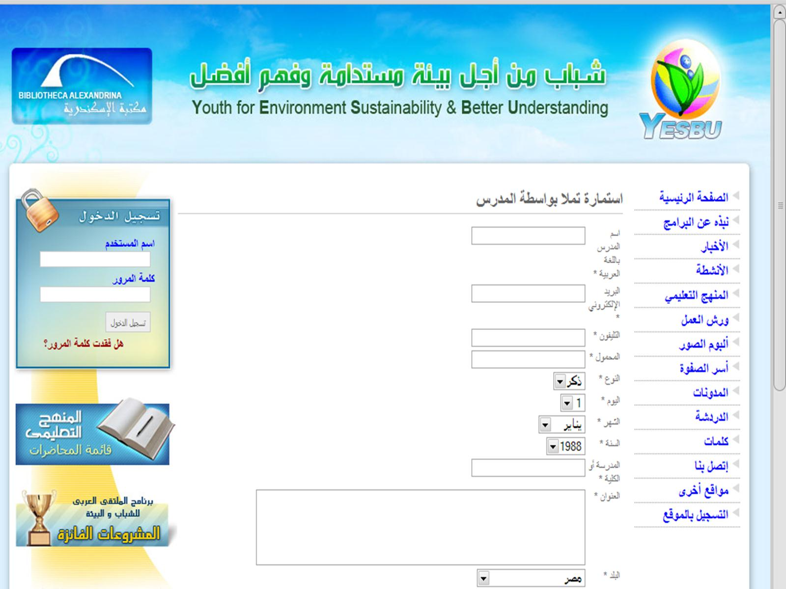

Slide 49
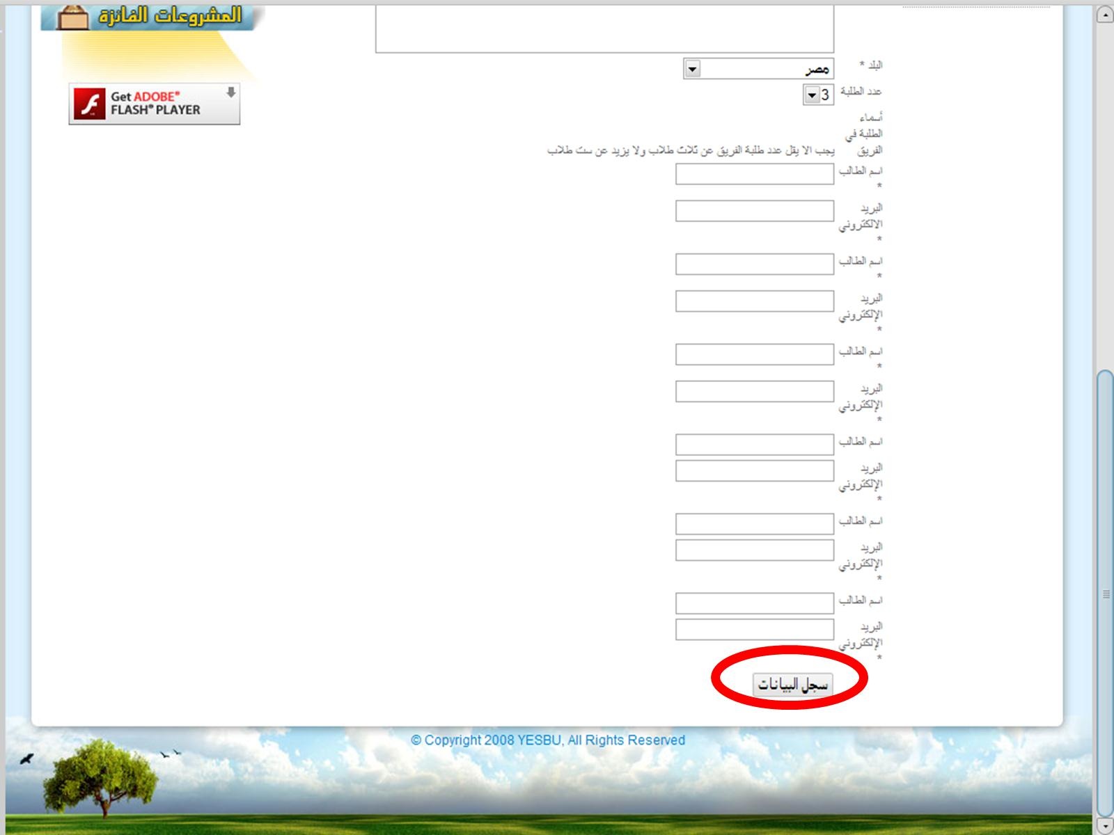

Slide 51
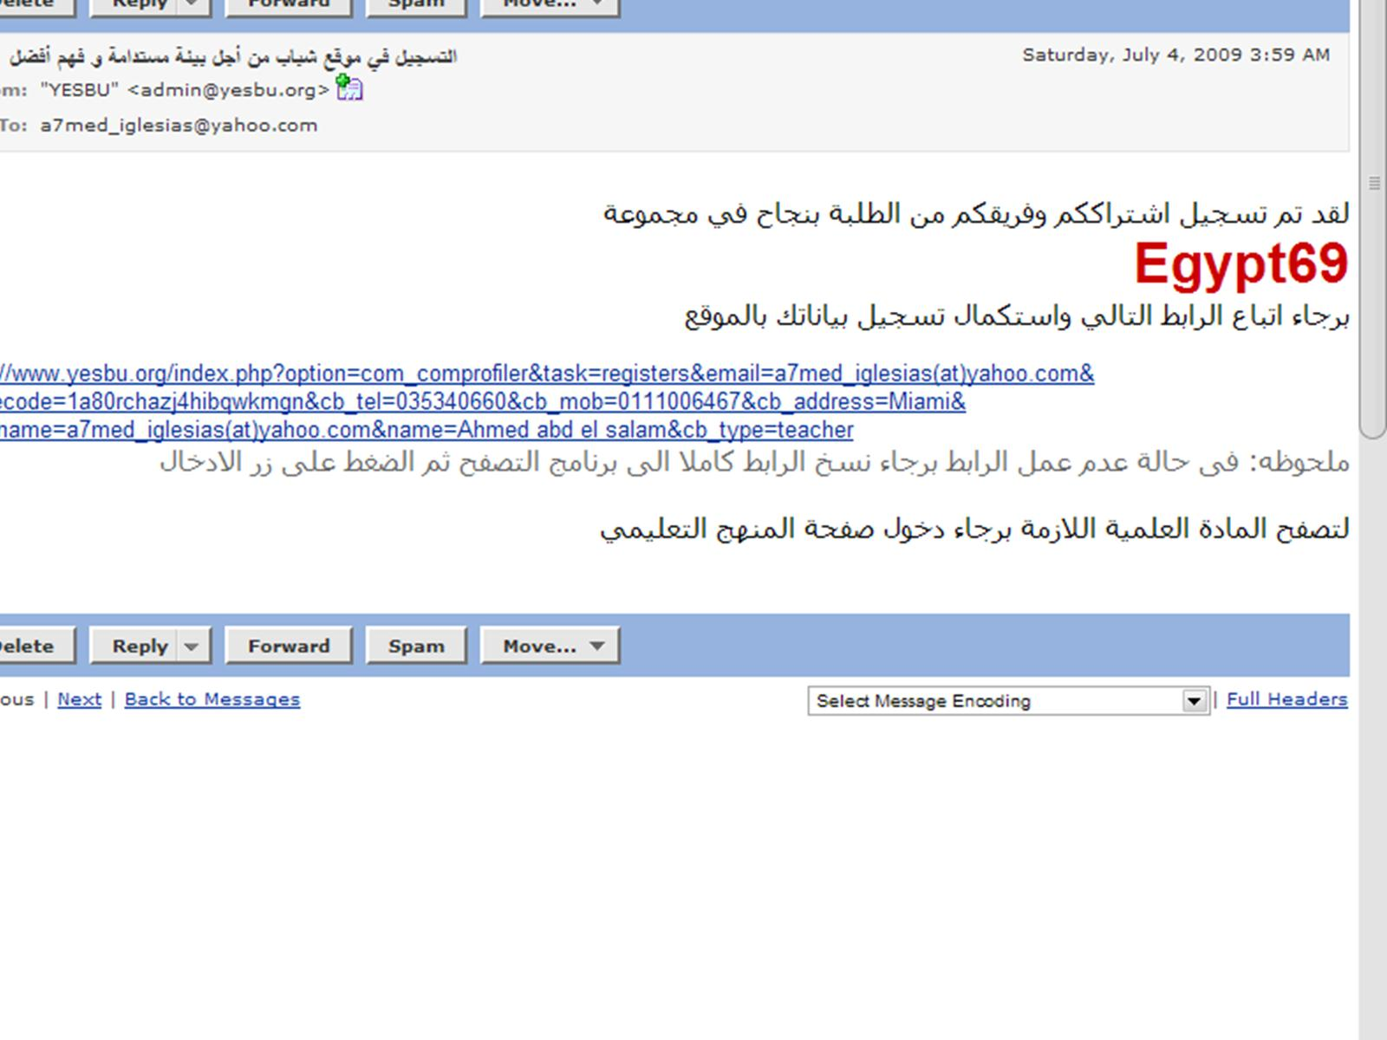

Slide 52
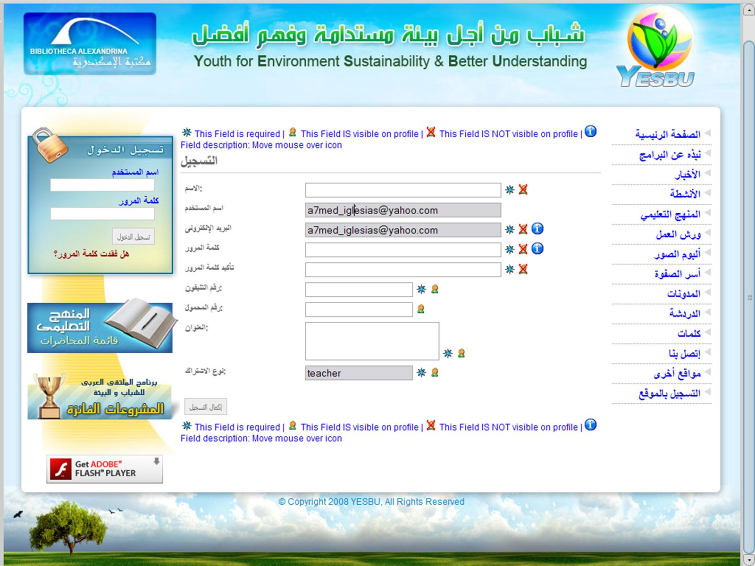

Slide 53
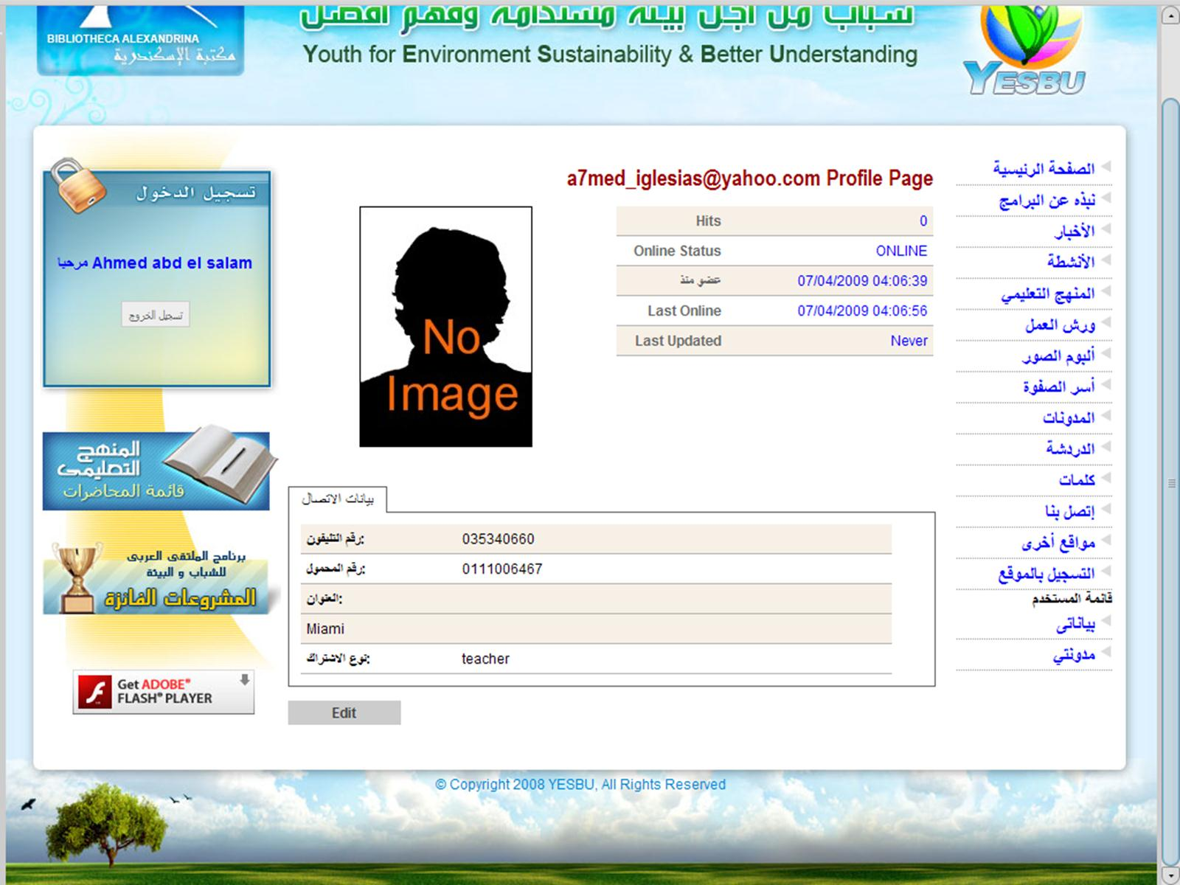

Slide 54
s

Slide 55
التعليم عن بعد

Slide 56
موقع المنهج باللغة العربية

Slide 57
موقع المنهج باللغة الإنجليزية

Slide 58
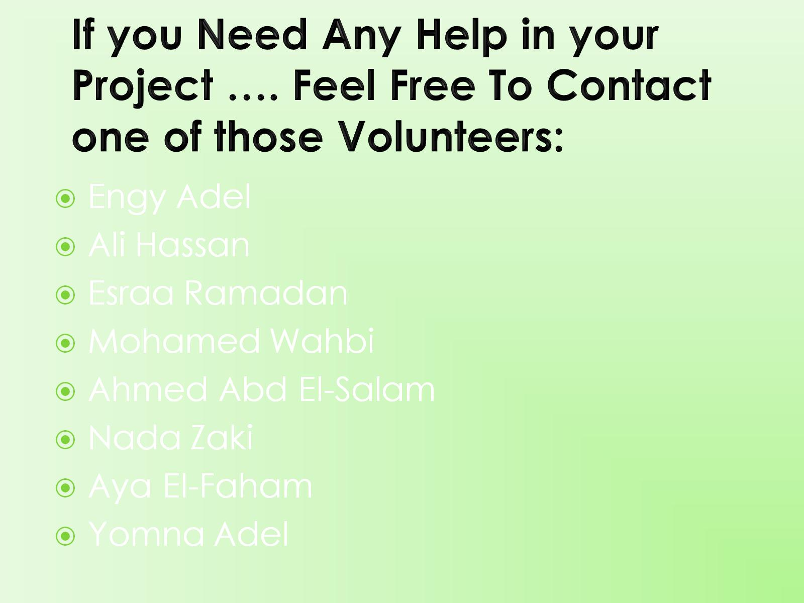
If you Need Any Help in your Project …. Feel Free To Contact one of those Volunteers:

Slide 59
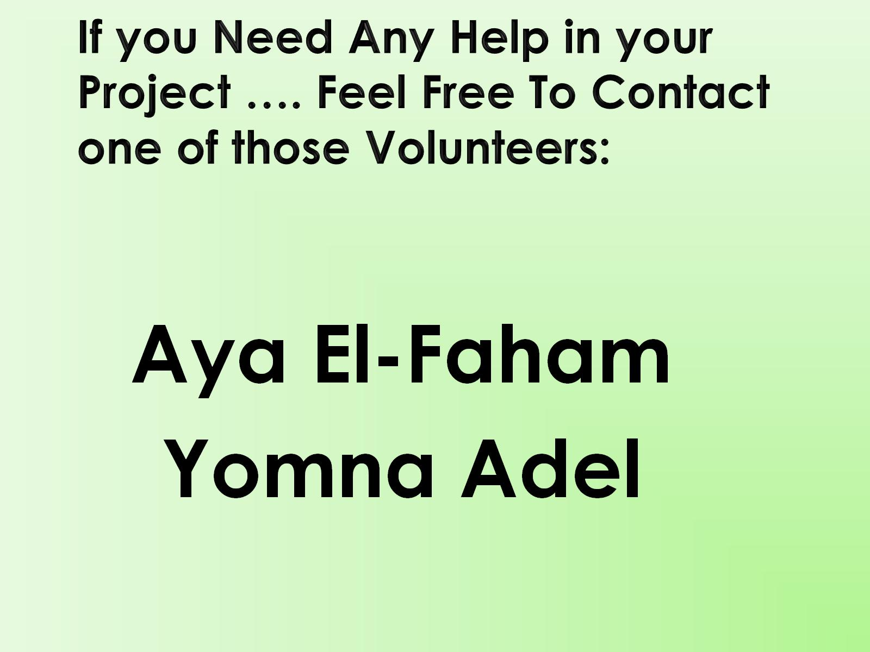
If you Need Any Help in your Project …. Feel Free To Contact one of those Volunteers:

Slide 60
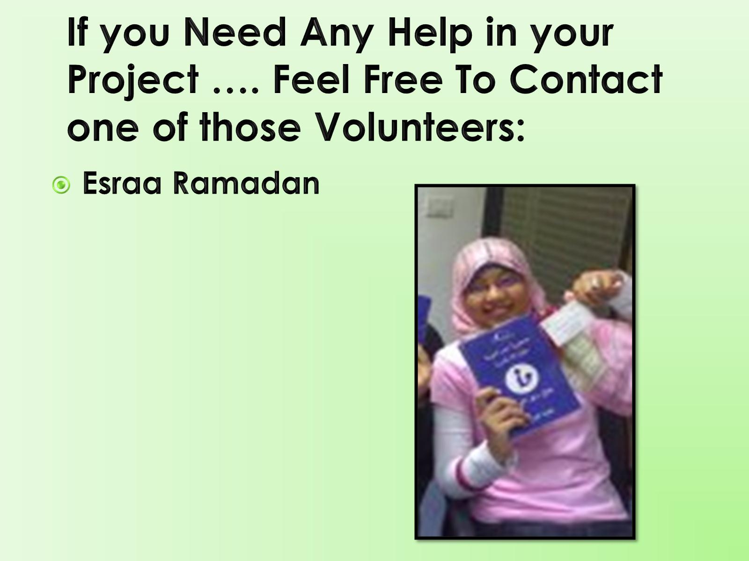
If you Need Any Help in your Project …. Feel Free To Contact one of those Volunteers:

Slide 61
If you Need Any Help in your Project …. Feel Free To Contact one of those Volunteers:

Slide 62
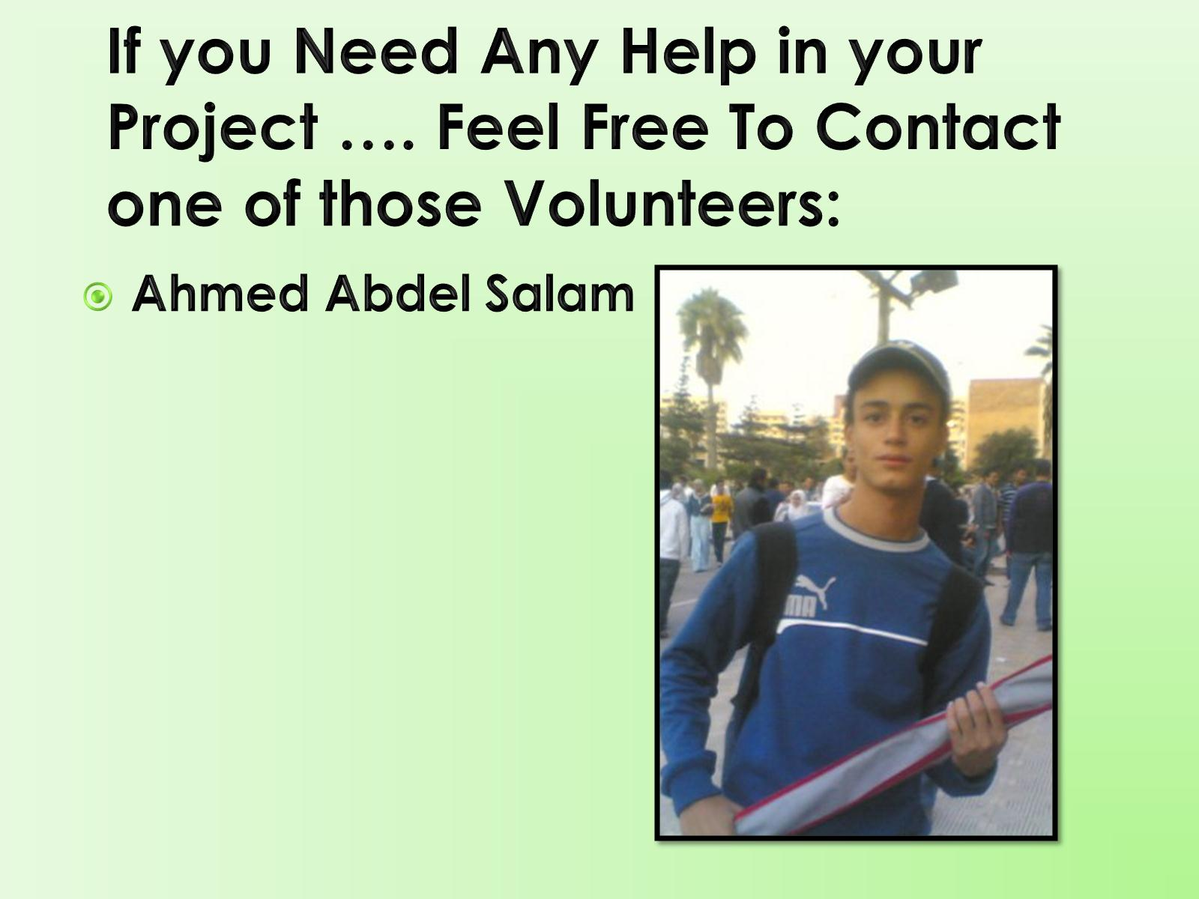
If you Need Any Help in your Project …. Feel Free To Contact one of those Volunteers:

Slide 63
If you Need Any Help in your Project …. Feel Free To Contact one of those Volunteers:

Slide 64
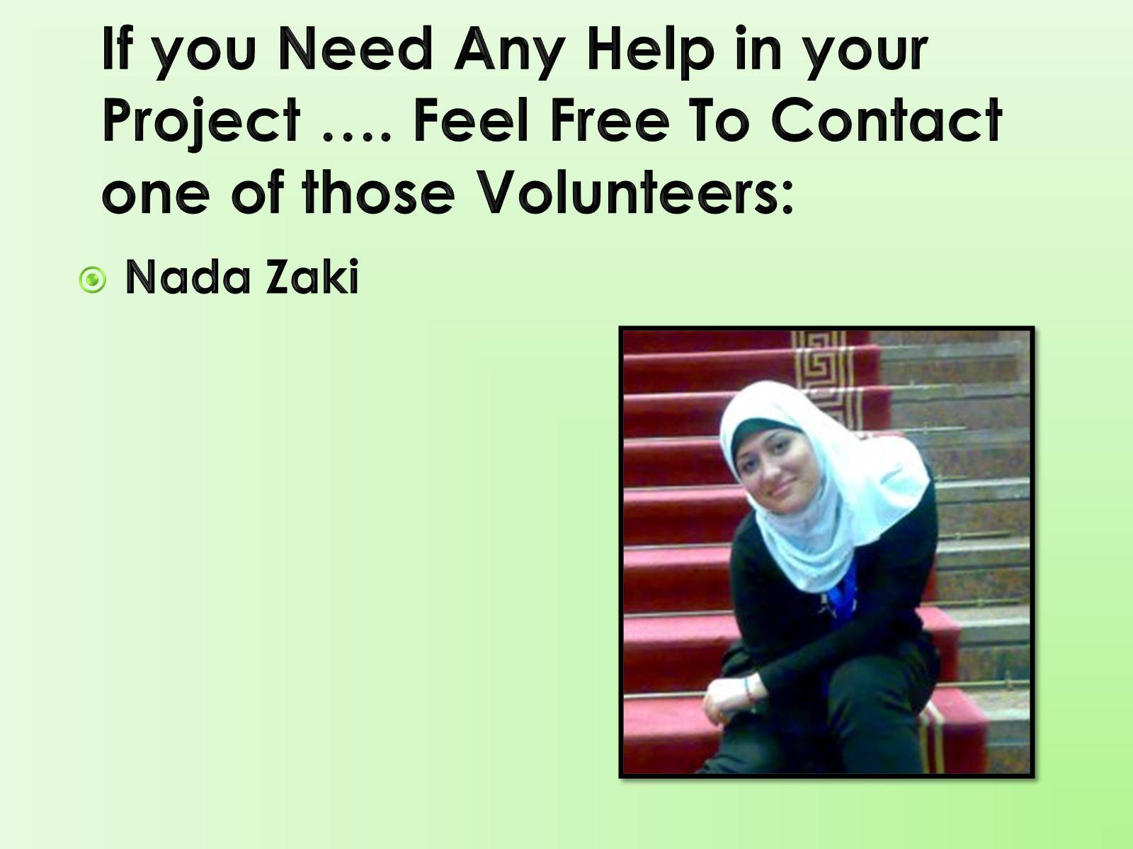
If you Need Any Help in your Project …. Feel Free To Contact one of those Volunteers:

Slide 65
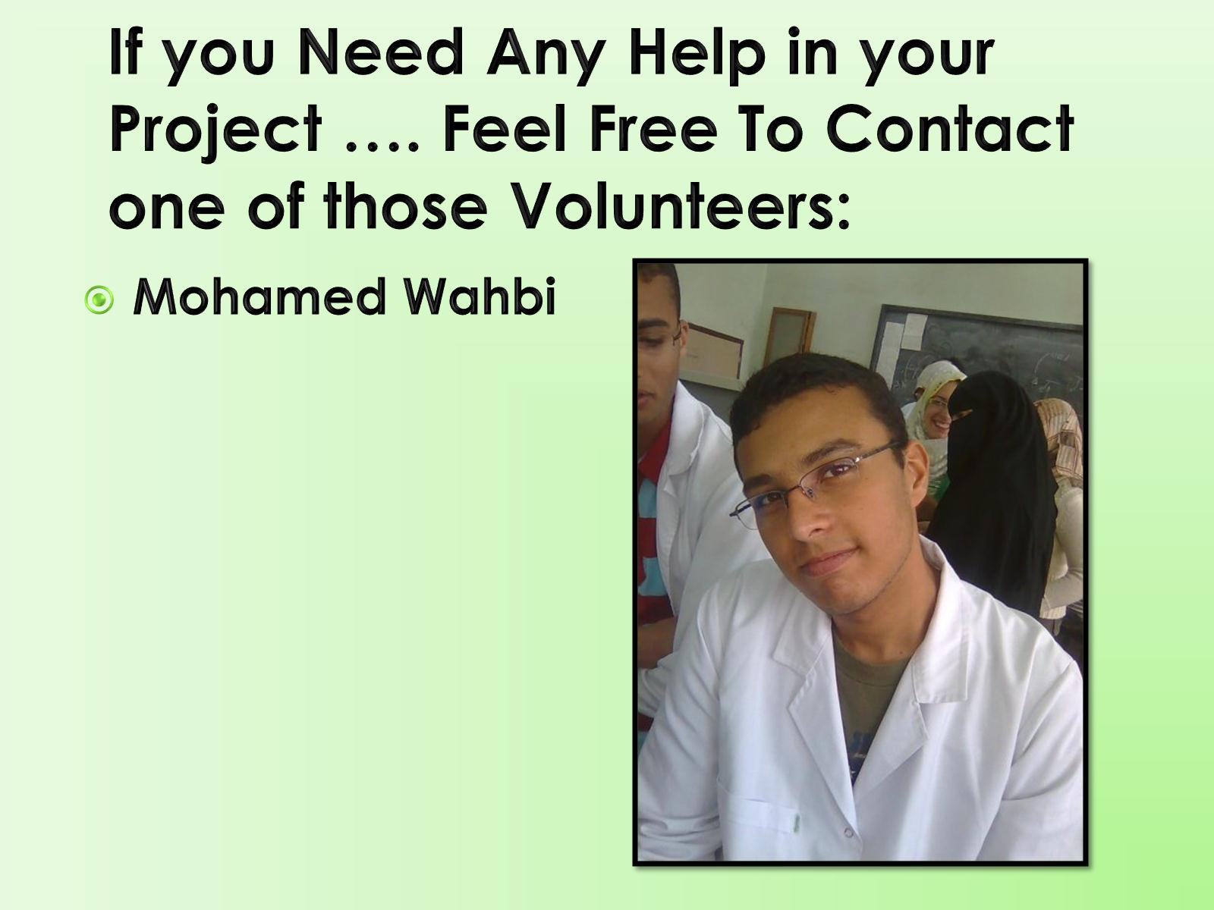
If you Need Any Help in your Project …. Feel Free To Contact one of those Volunteers:

Slide 66
كن معنا لنصبح المستقبل المشرق لبلدنا

Slide 69
The First Presentation

Slide 70
References

